Slide 1

Lifestyle Store
E-Commerce website
Detailed Developer Report
Rohan chaudhari

Slide 2
Security Status — Extremely Vulnerable
Hacker can steal all records in lifestyle store databases (SQLi)
Hacker can take control of complete server including View, Add, Edit, Delete files and folders (Shell Upload)
Hacker can change source code of application to host malware, phishing pages or even explicit content (Shell Upload)
Hacker can inject client side code into applications and trick users by changing how page looks to steal information or spoil the name of Internshala (XSS)
Hacker can extract mobile number of all customers using User id (IDOR)
Hacker can get access to seller details and login into the website using customer of the month usernames(PII)
Hacker can send multiple requests (Rate Limiting Flaw).
Hacker can add /remove items in the cart (CSRF)
Use off http instead of https.
Cookie Flaws
Rohan Chaudhari

Slide 3
Vulnerability Statistics
Critical
Severe
Moderate
13
15
8
Low
4

Slide 4
Vulnerabilities Found :
No. | Severe | Vulnerability | Count
1 | Critical | SQL Injection | 2
2 | Critical | Insecure /arbitrary file uploads | 1
3 | Critical | Access to admin panel | 1
4 | Critical | Access via OTP bypass | 2
5 | Critical | Insecure Direct Object Reference | 4
6 | Critical | Command execution | 2
7 | Severe | Reflected and Stored Cross Site Scripting | 2
8 | Severe | Crypto configuration Flaw | 1
9 | Severe | Weak Passwords | 2
10 | Severe | Unauthorized availability of details | 2
11 | Severe | Open redirection | 3
12 | Moderate | Default files and pages | 3
13 | Moderate | PII Leakage | 1
14 | Moderate | Components with known vulnerabilities | 2

Slide 5
SQL Injection :
This allows a hacker to inject server side codes or commands.
These are the flaws that allows a hacker to inject codes/commands into the web server that can provide unauthorized access to the data
SQL Injection (Critical) | Below mentioned URL in the T-shirt/socks/shoes module is vulnerable to SQL injection attack . Affected URL : http://3.109.217.174/products.php?cat=1 Affected Parameters : cat (GET parameter) Payload : http://3.109.217.174/products.php?cat=1’ Affected URL : http://3.109.217.174/search/search.php?q=socks Affected Parameter : q (GET parameter) Payload : http://3.109.217.174/search/search.php?q=socks’

Slide 6
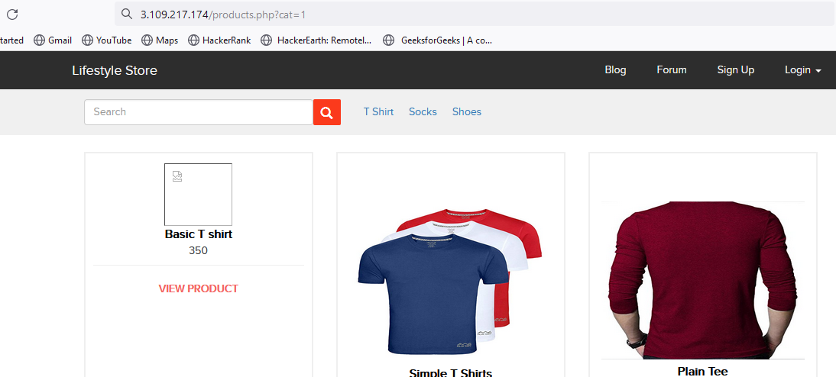
Observation :
After logging in as a customer, click on T-shirts text. Notice the GET parameter cat=1 in the URL :

Slide 7
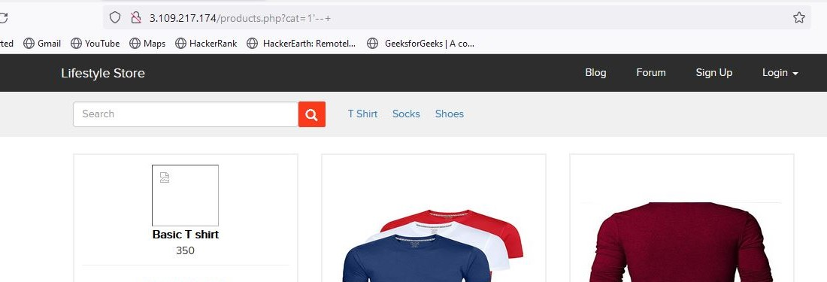
Observation :
We apply single quote in house parameter : products.php?cat=1’ and we get complete MySQL error:
We then put --+ : products.php?cat=1’--+ and the error is removed where I can use SQL queries, confirming SQL injection

Slide 8
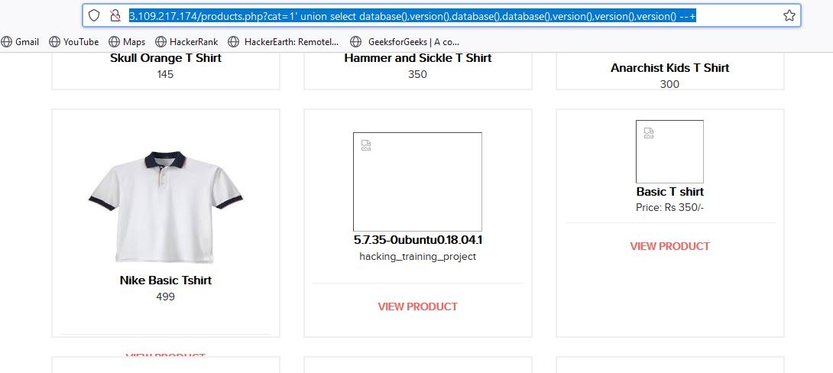
Proof of Concept (PoC) :
Attacker can execute SQL commands as shown below. Here I have used the payload below to extract the database name and MySQL version information : http://3.109.217.174/products.php?cat=1’union select database(),version(),database(),database(),version(),version(),version() --+

Slide 9
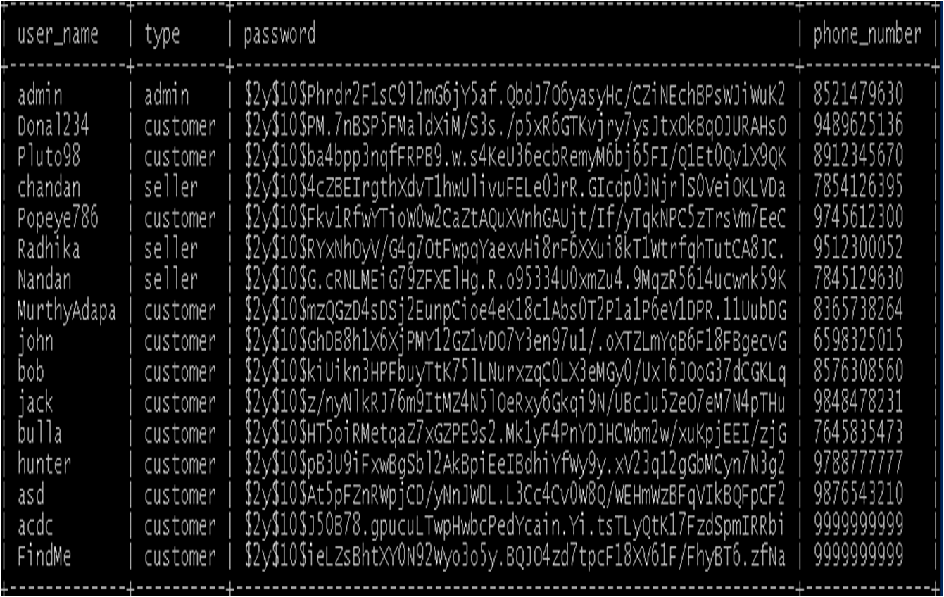
Proof of Concept (PoC) :
•No of databases: 2
•information_schema
•hacking_training_project
•No of tables in SQL_Injection_V3: 10
•brands
•cart_items
•categories
•customers
•order_items
•orders
•product_reviews
•products
•sellers
•users

Slide 10
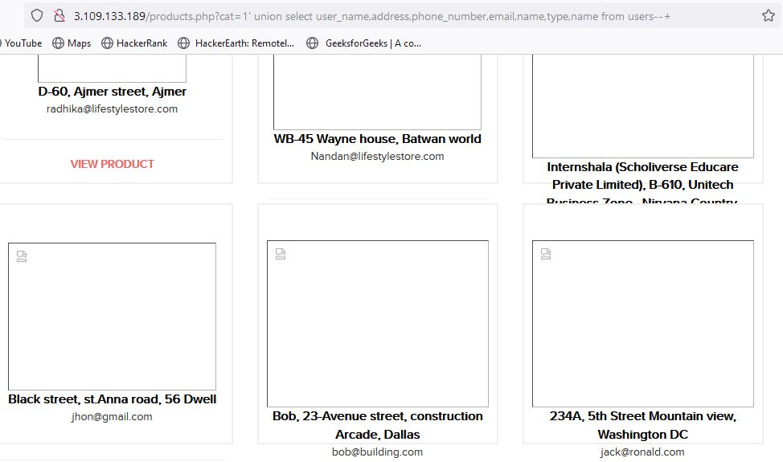
Business Impact - Extremely High
Using this vulnerability, attacker can execute arbitrary SQL commands on Lifestyle store server and gain complete
access to the databases along with all customer data inside it.
Below is the screenshot of some information extracted from users table which shows user credentials being leaked .Since the passwords are hashed ,the risk is comparatively low .

Slide 11
Attacker can use this information to attack the users and login to admin panels and gain complete admin level access to the website which could lead to complete compromise of the server and all other servers connected to it.
Recommendation :
Take the following precautions to avoid exploitation of SQL injections:
•Whitelist User Input: Whitelist all user input for expected data only. For example if you are expecting a flower name, limit it to alphabets only upto 20 characters in length. If you are expecting some ID, restrict it to numbers only
•Prepared Statements: Use SQL prepared statements available in all web development languages and frameworks to avoid attacker being able to modify SQL query
•Character encoding: If you are taking input that requires you to accept special characters, encode it. Example. Convert all ‘ to \’ , “ to \”, \ to \\. It is also suggested to follow a standard encoding for all special characters such has HTML encoding, URL encoding etc
•Do not store passwords in plain text. Convert them to hashes using SHA1 SHA256 Blowfish etc
•Do not run Database Service as admin/root user
•Disable/remove default accounts, passwords and databases
•Assign each Database user only the required permissions and not all permissions.
References :
https://www.owasp.org/index.php/SQL_Injection/
https://en.wikipedia.org/wiki/SQL_injection

Slide 12
2. Insecure /Arbitrary File Uploads This happens when the applications do not implement proper type file check and allow uploading files of different file formats. For example a PHP file instead of jpeg picture in the profile.
Insecure /Arbitrary File Uploads (Critical) | The attacker can upload insecure shells and files and gain access over the entire database and login as the admin and the vesion is known to have vulnerabilities . Affected URL : http://3.109.133.189/wondercms/ Affected Parameters : File Upload (POST parameter) The attacker can upload files with extension other than .jpeg . Affected URL : http://3.109.133.189/profile/16/edit/ Affected Parameter : Upload Profile Photo (POST parameter)

Slide 13
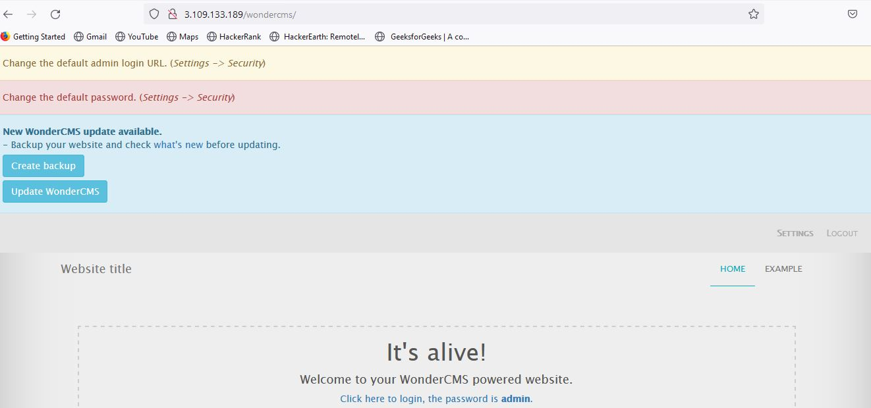
Observation :
Login using any of the user’s details on the Lifestyle store and navigate to Blog tab .
Now click on Login and put the password - admin.
You will see the following page and then click on Settings tab .

Slide 14
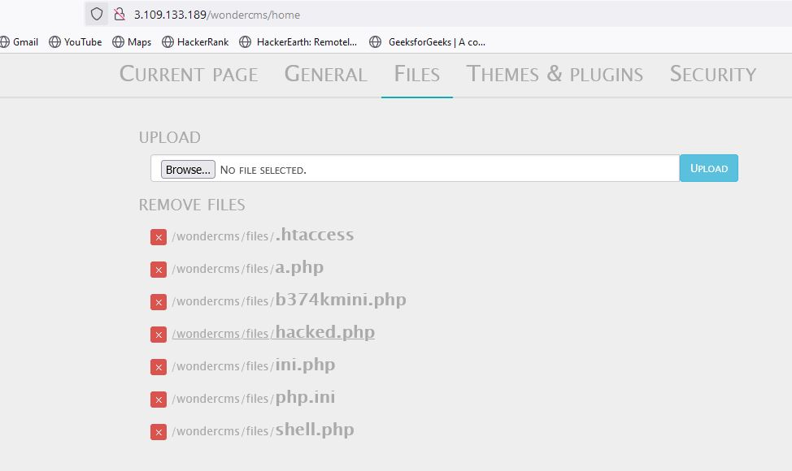
Observation :
Click on Files tab .
Here hacker can upload the file like shown .
Click on the uploaded file hacked1.php and it will be opened.

Slide 15
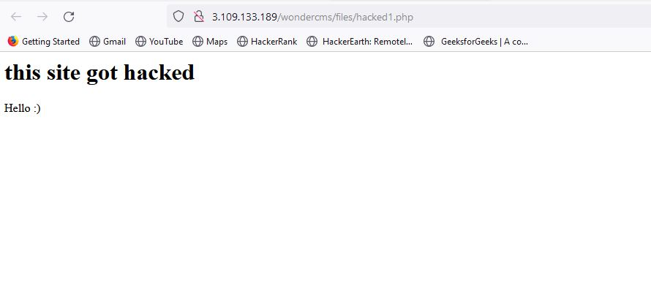
Proof of Concept (PoC) :
• Weak password - admin.
• Arbitrary File Inclusion.
Below is the result of the uploaded file in the previous slide likewise some malicious shell can be uploaded as well.

Slide 16
Business Impact – Extremely High
Any backdoor file or shell can be uploaded to get access to the uploaded file on remote server and data can be exfiltrated.
The presence of an actual malicious file can compromise the entire system leading to system takeover/data stealing.
Recommendation :
Change the Admin password to something strong and not guessable.
The application code should be configured in such a way, that it should block uploading of malicious files extensions such as exe/ php and other extensions with a thorough server as well as client validation. CVE ID allocated: CVE-2017-14521.
Rename the files using a code, so that the attacker cannot play around with file names.
Use static file hosting servers like CDNs and file clouds to store files instead of storing them on the application server itself.
References
https://www.owasp.org/index.php/Unrestricted_File_Upload
https://www.opswat.com/blog/file-upload-protection-best-practices

Slide 17
3.Access to admin panel :
Access to Admin Panel (critical) | Below mentioned URL is vulnerable to Arbitrary File Upload and making other admin level changes Affected URL : http://3.109.133.189/wondercms/

Slide 18
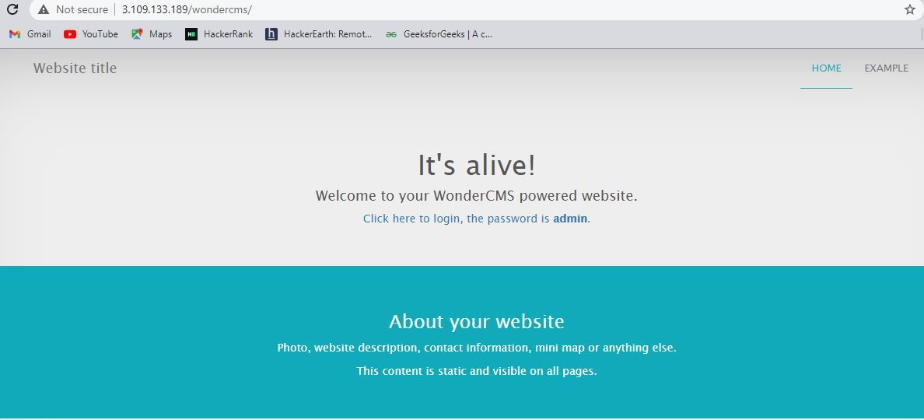
Observation :
When we navigate to http://3.109.133.189/wondercms/ in the URL it is - http://3.109.133.189/wondercms/loginURL .
This page is displaying the password as admin .

Slide 19
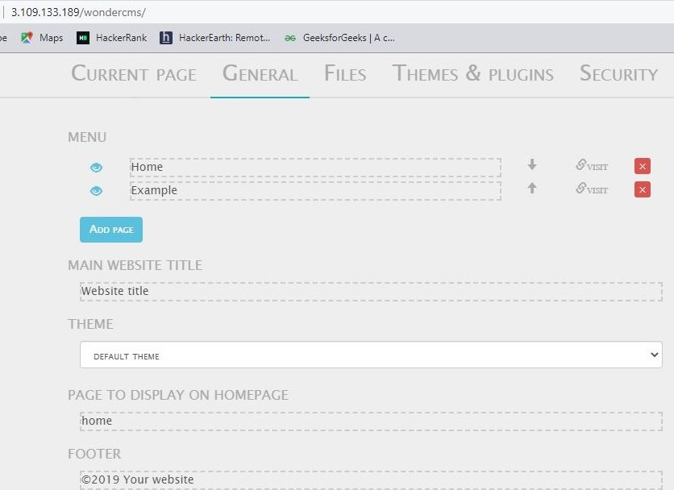
Proof of Concept (PoC) :
Hacker can change the admin login password making the actual admin unable to login the next time. Hacker can also add and delete pages .

Slide 20
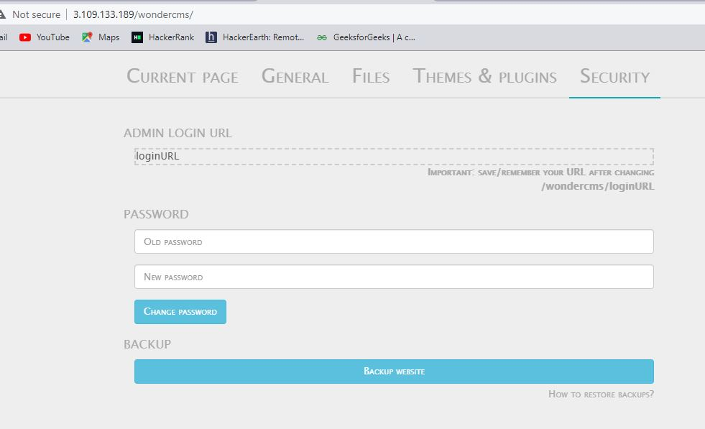

Slide 21
Business impact - Extremely High
•Using this vulnerability ,the attacker can get complete access to the blog of the website.
•The attacker can change the password or even change the URL of the admin panel and restrict the admin to access it.
•Even pages can be created and deleted along with editing.
•Files can be added without verification and hence can be dangerous to the entire website, as the control of the entire website can be taken.
•A hacker can also change/install/update/remove the themes and plugins that were added.
Recommendation :
•The default password should be changed and a strong password must be setup.
•The admin URL must also be such that its not accessible to normal users.
•Password changing option must be done with 2 to 3 step verification.
•Password must be at least 8 characters long containing numbers , alphanumerics , etc.
•All the default accounts should be removed.
•Password should not be reused.
References :
https://www.owasp.org/index.php/Testing_for_weak_password_change_or_reset_functionalities
(OTG- AUTHN-009)
https://www.owasp.org/index.php/Default_Passwords
https://www.us-cert.gov/ncas/alerts/TA13-175A

Slide 22
4.Access via OTP Bypass
Access via OTP Bypass(Critical) | The Admin dashboard at the below mentioned URL has 3 digit otp allowing brute forcing the otp and reset the password and gaining access . Affected URL : http://3.109.133.189/reset_password/admin.php Affected Parameters : OTP (GET parameters) Payload used : Used OTP = 859 http://13.126.253.118/reset_password/admin.php?otp=859 The coupon code at the below mentioned URL can be brute forced. Affected URL : http://13.126.253.118/cart/cart.php Affected Parameter : apply_coupon(POST parameters) Payload used : UL_1247

Slide 23
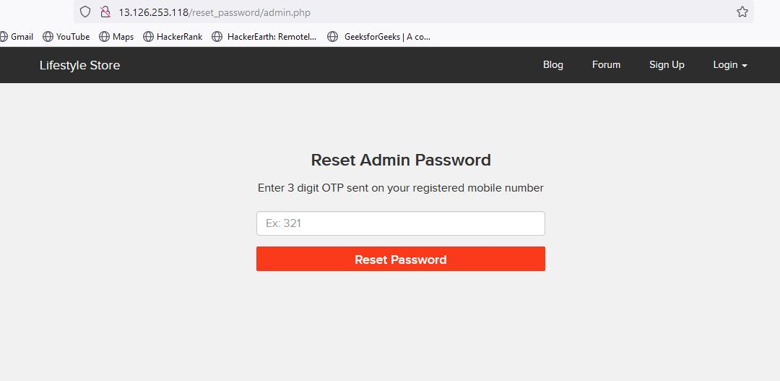
Observation :
Navigate to http://13.233.123.35/reset_password/admin.php
You will see reset password page via OTP. Enter random OTP while capturing requests in a local proxy .

Slide 24
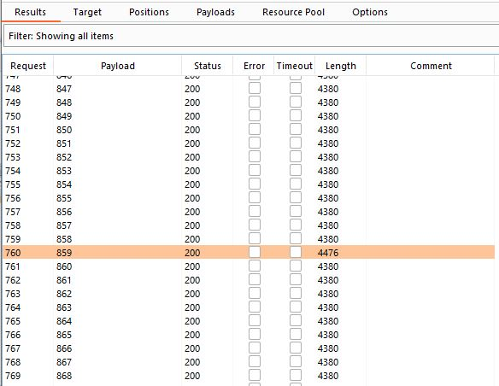
Observation :
On brute forcing the 3 digit OTP , under the length column the value which is distinct from others yields the correct
OTP = 859 (img 1).
Enter this otp in the captured request (img 2).
img 1

Slide 25
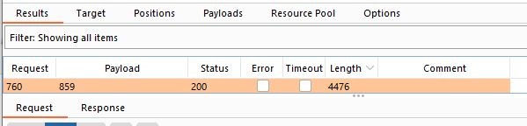
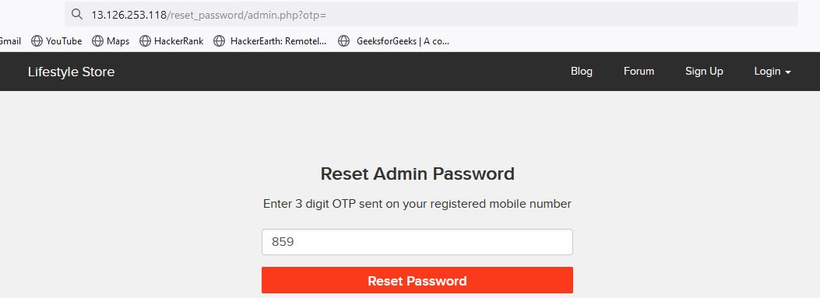
img 2

Slide 26
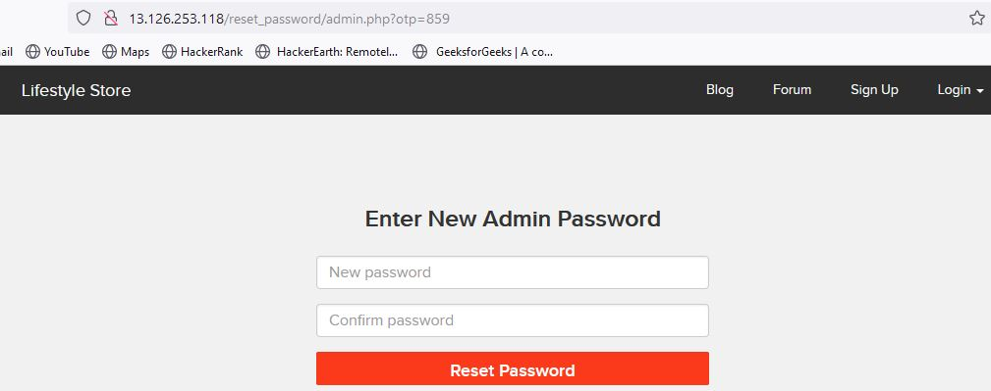
Observation :
You will be navigated to the reset password page . Here change the password (img 1).
Navigate to - http://13.126.253.118//login/admin.php . Enter username-admin and password (img 2).
img 1

Slide 27
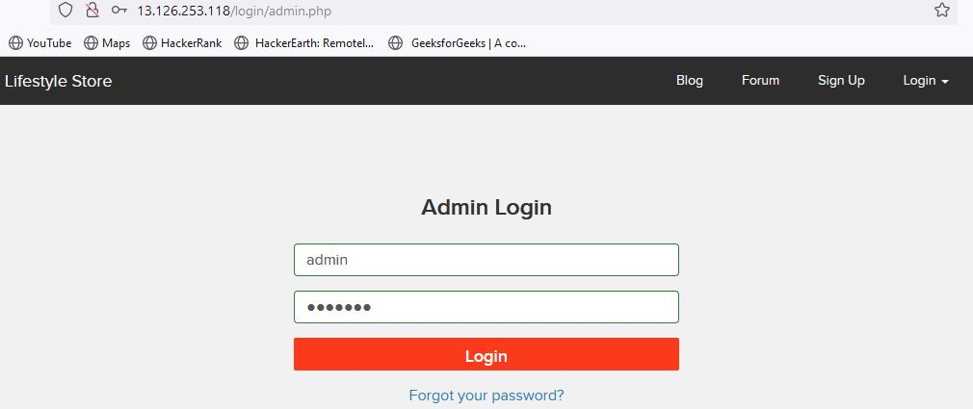
img 2

Slide 28
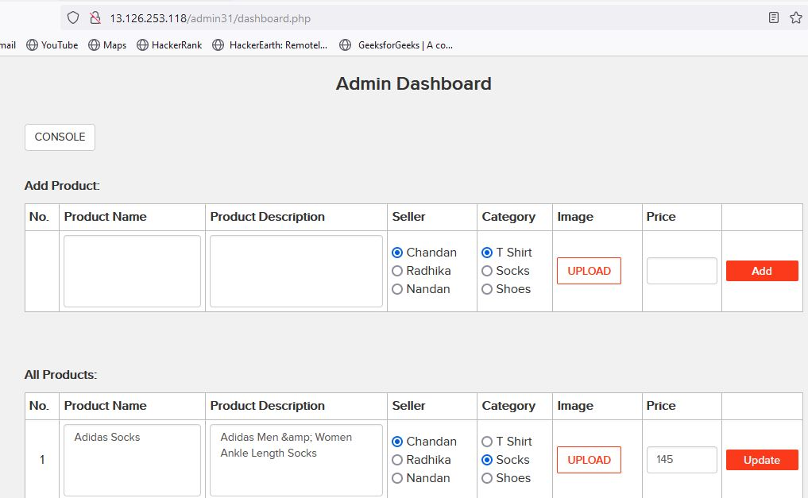
Observation :
You will be redirected to the admin dashboard where you can see the details of all the users/sellers/customers.

Slide 29
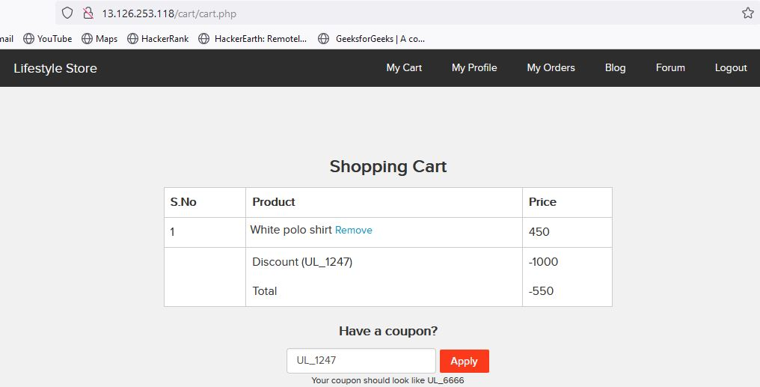
Proof of Concept (PoC) :
At URL - http://13.126.253.118/cart/cart.php coupon code – UL_1247 is applied .

Slide 30
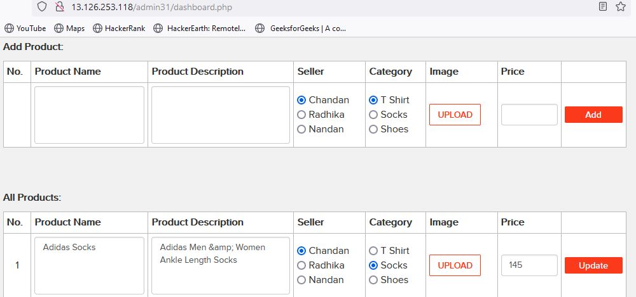
Business Impact – Extremely High
A malicious hacker can gain access to any account and change the information about the products. This may lead to defamation of the seller and the website which the customer trusts. Attacker once logs in can then carry out actions on behalf of the admin which could lead to serious loss to any user .

Slide 31
Recommendation :
Take the following precautions:
Use proper rate-limiting checks on the no of OTP checking and Generation requests .
Implement anti-bot measures such as ReCAPTCHA after multiple incorrect attempts .
OTP should expire after certain amount of time like 2 minutes.
OTP should be at least 6 digit and alphanumeric for more security .
References :
https://www.owasp.org/index.php/Testing_Multiple_Factors_Authentication_(OWASP-AT-009)
https://www.owasp.org/index.php/Blocking_Brute_Force_Attacks

Slide 32
5.Unauthorised Access To Customer Details :
Unauthorised Access To Customer Details (Critical) | The below mentioned login page allows you to change password without verification and view details of other customers (CSRF). Affected URL : http://13.233.123.35/reset_password/customer.php Affected Parameters : Reset Password button (POST parameter) We can change the details of the user’s account details. Affected URL : http://13.233.123.35/profile/2/edit/ Affected Parameters : Update button (POST parameter)

Slide 33
5.Unauthorised Access To Customer Details :
Unauthorised Access To Customer Details (Critical) | Similarly after gaining access over the account , Hacker can remove/add/confirm items in the cart of the user (CSRF). Affected URL : http://13.233.123.35/cart/cart.php Affected Parameters : Remove option (POST parameter) Affected URL : http://13.233.123.35/cart/cart.php Affected Parameters : Confirm order option (POST parameter)

Slide 34
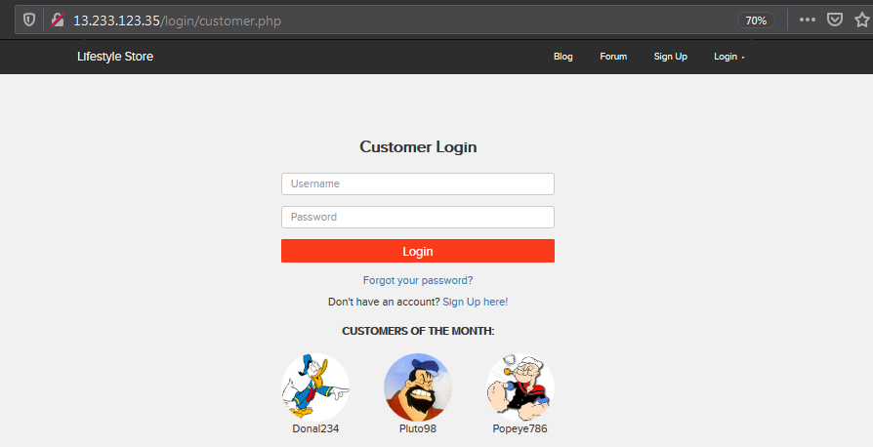
Observation :
Navigate to http://13.233.123.35/login/customer.php.
Copy any of the CUSTOMERS OF THE MONTH’s username

Slide 35
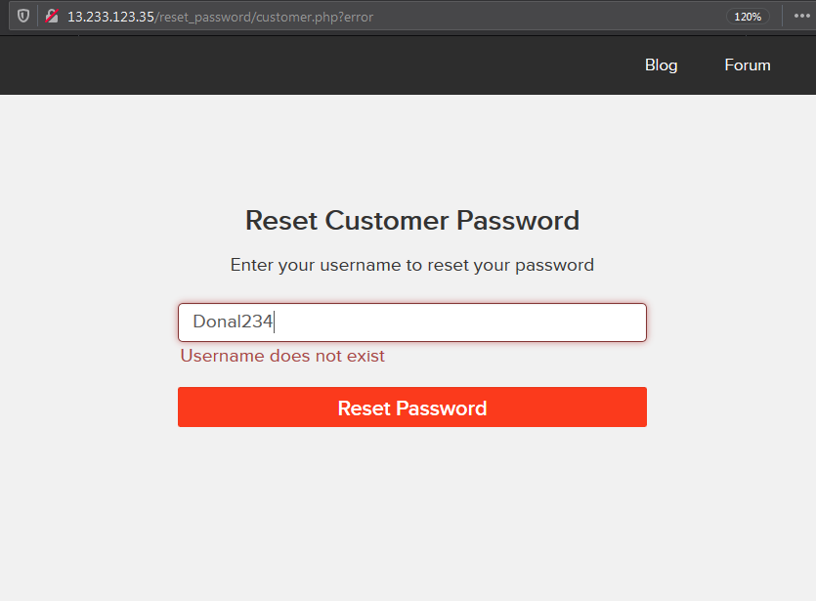
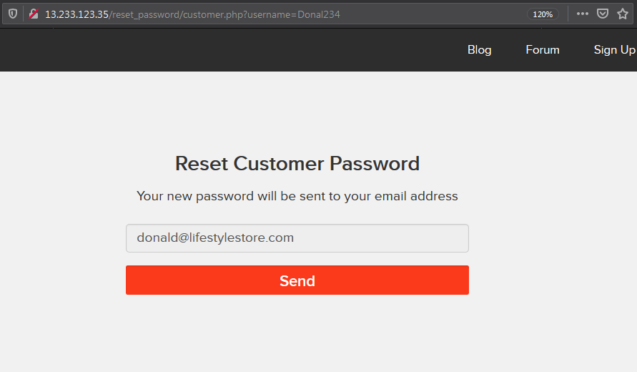
Observation :
Navigate to http://13.233.123.35/reset_password/customer.php .
Paste the copied username and click on Reset Password button.
You will be redirected to the following page . Click send.

Slide 36
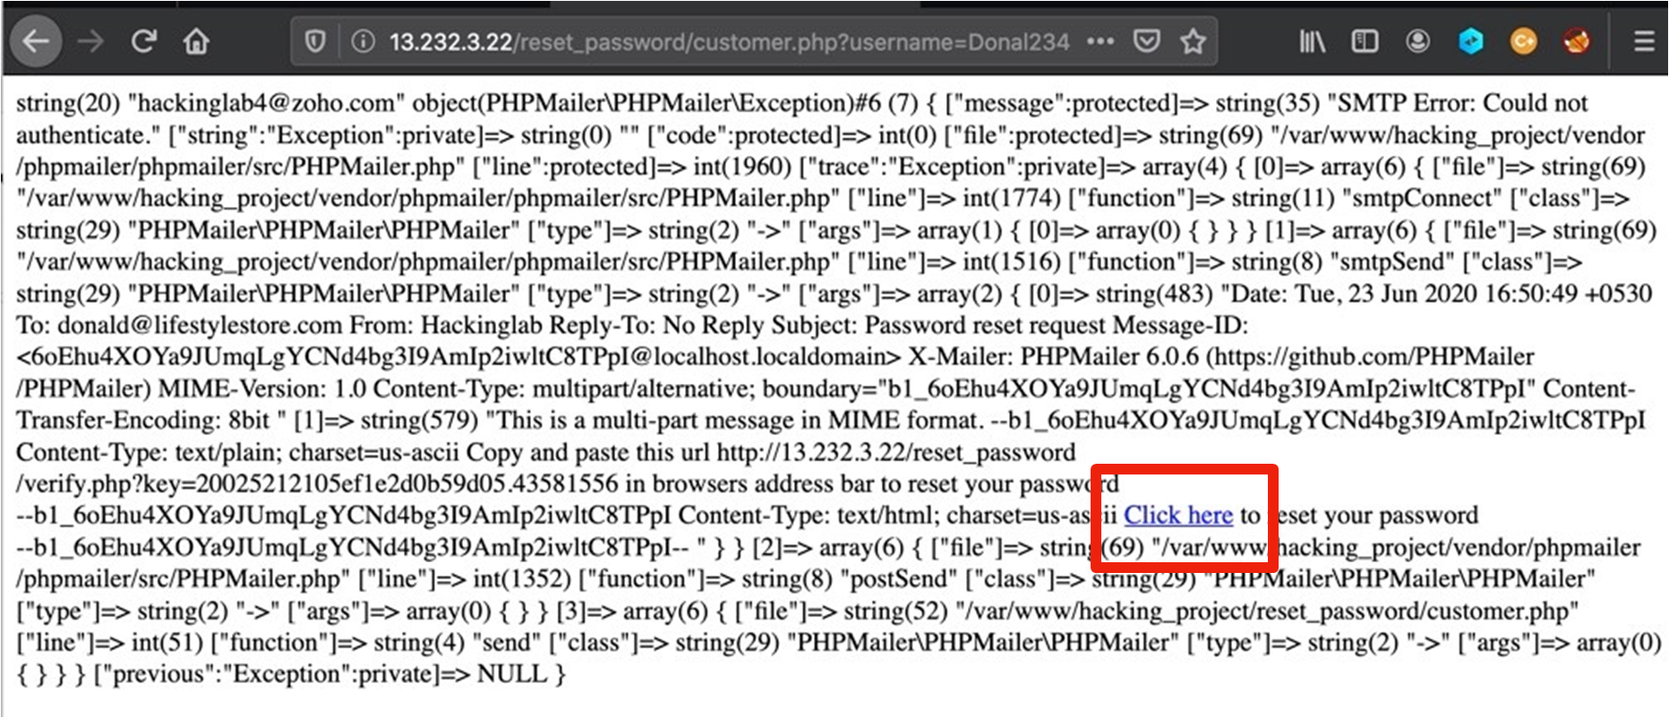
Observation :
You will be redirected to the following page. Then click on click here.
Then you can change the password .

Slide 37
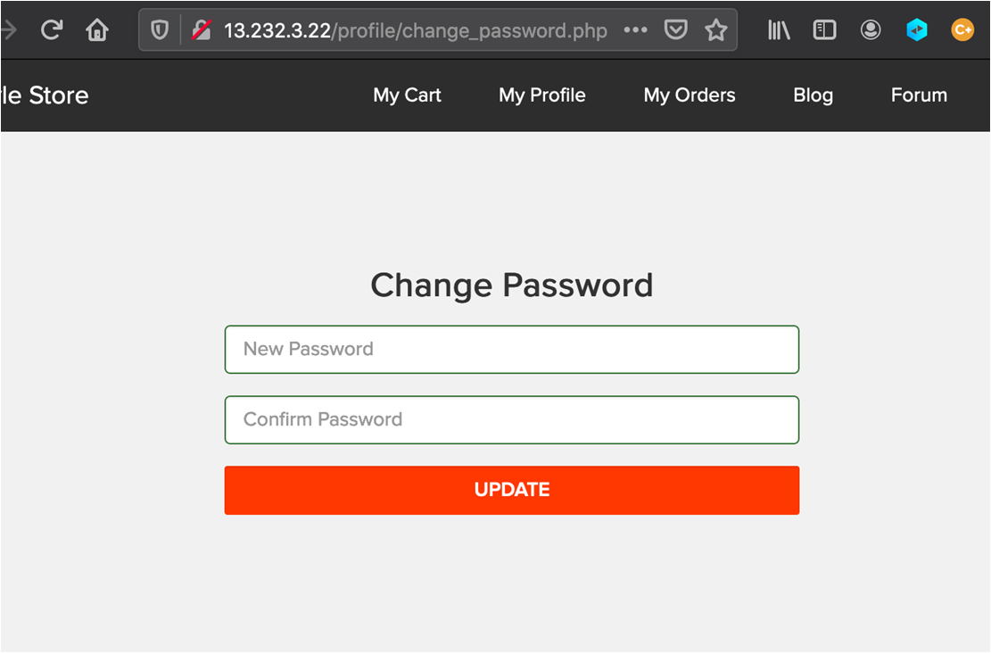
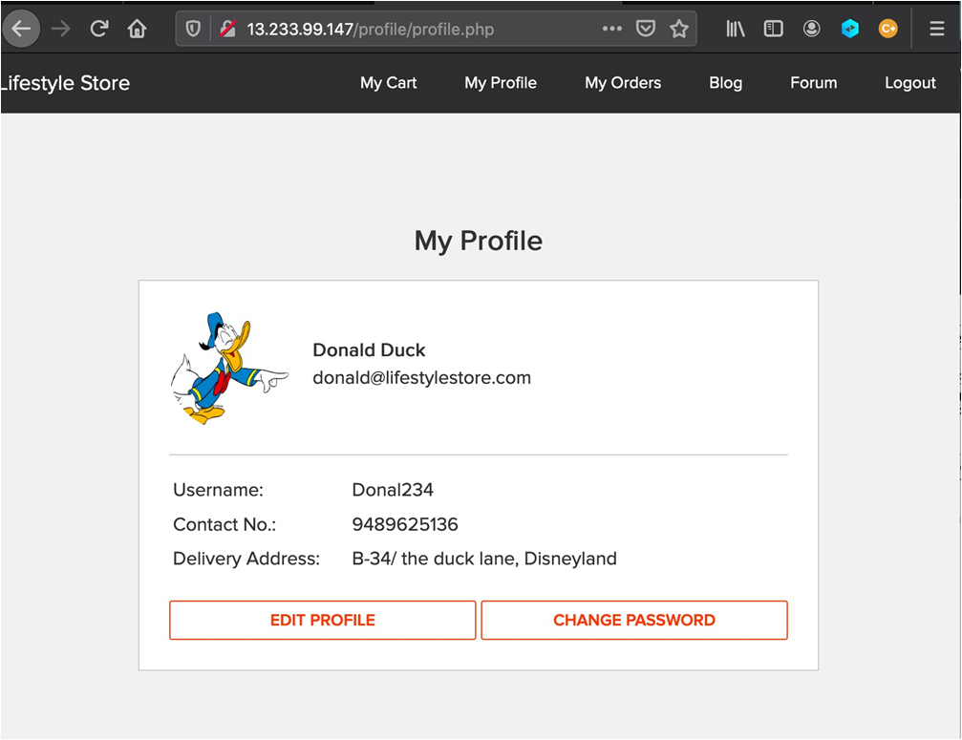
Proof of Concept (PoC) :
• Attacker can change the details and password of the customer easily and can place orders on user’s behalf.

Slide 38
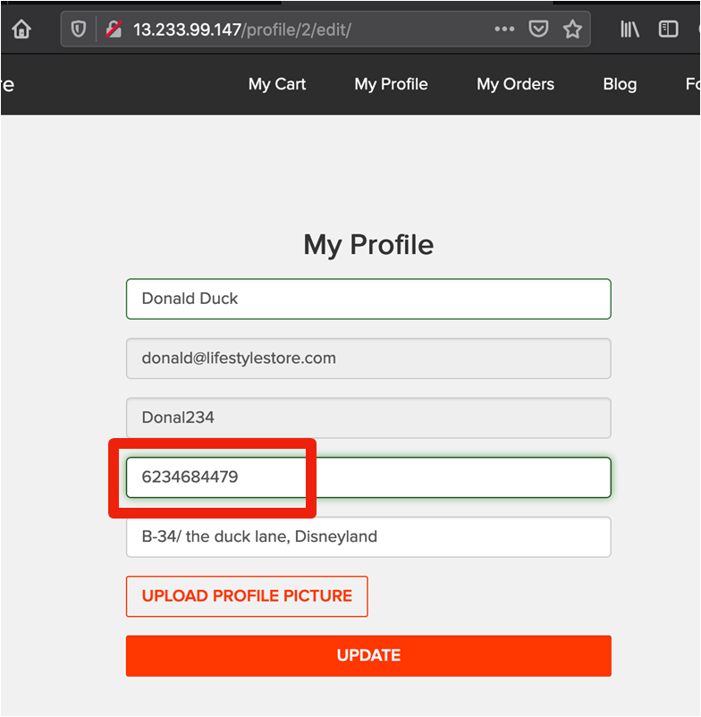
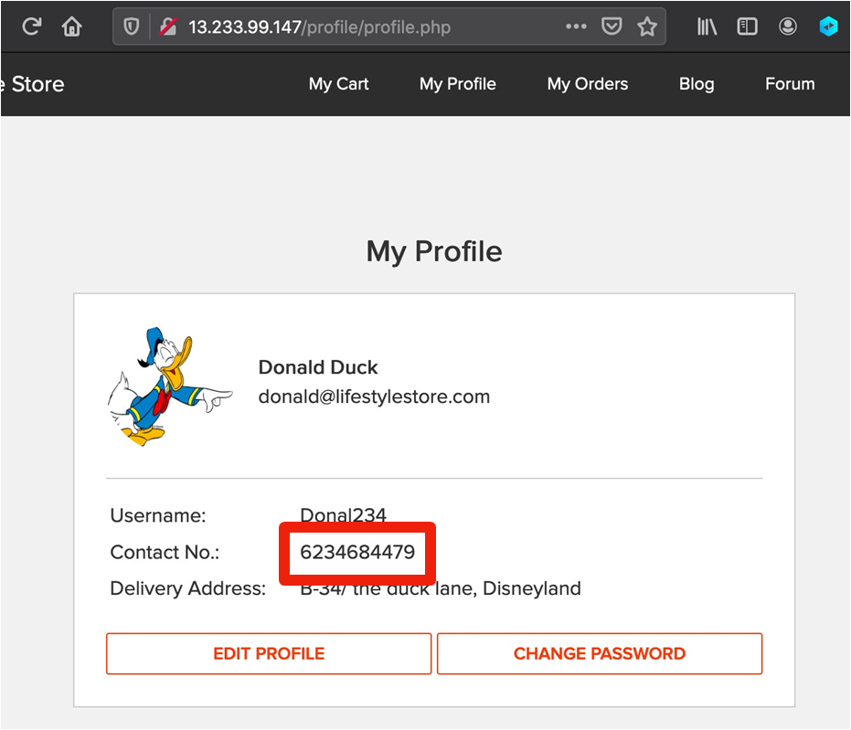
Business Impact - Very High
A malicious hacker can gain complete access to customer's account just by clicking on forgot password. This leads to complete compromise of personal user data of the customer.
Attacker once logs in can then carry out actions on behalf of the victim which could lead to serious financial loss to him/her. Below are the screenshots of changing the phone number of the attacked user.

Slide 39
Recommendation :
Implement an Anti-CSRF Token.
Do not show the customers of the month on the login page.
Use the SameSite Flag in Cookies.
Check the source of request made.
Take some extra keys or tokens from the user before processing an important request.
Use 2 factor confirmations like otp , etc. for critical requests.
References :
https://www.netsparker.com/blog/web-security/csrf-cross-site-request-forgery/
https://digitalguardian.com/blog/how-secure-personally-identifiable-information-against-loss-or-compromise

Slide 40
6.Command Execution Vulnerability
Command Execution Vulnerability (Critical) | Below mentioned URLs is vulnerable to Command Execution. Affected URL : http://13.126.253.118/admin31/console.php Shell can be uploaded at files tab to access the server details at : http://13.126.253.118/wondercms/ Affected Parameters : Command (POST parameter)

Slide 41
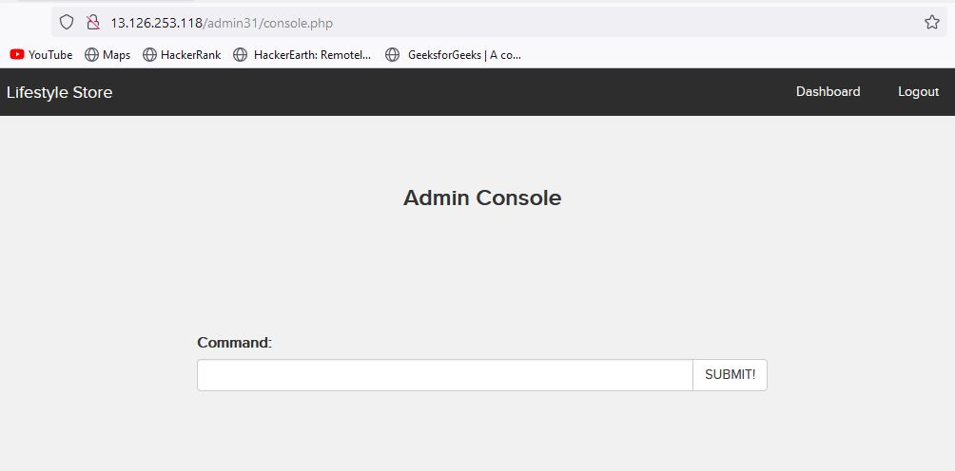
Observation :
• Navigate to - http://13.126.253.118/admin31/console.php after logging in as the admin and you will see the following page.

Slide 42
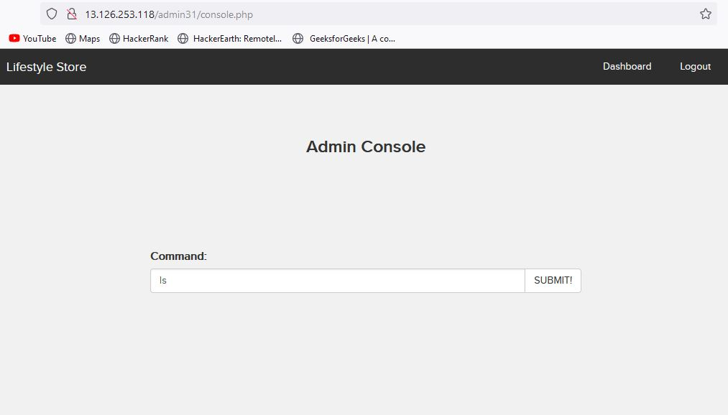
Proof of Concept (PoC) :
When command ls is entered the following output is visible.

Slide 43
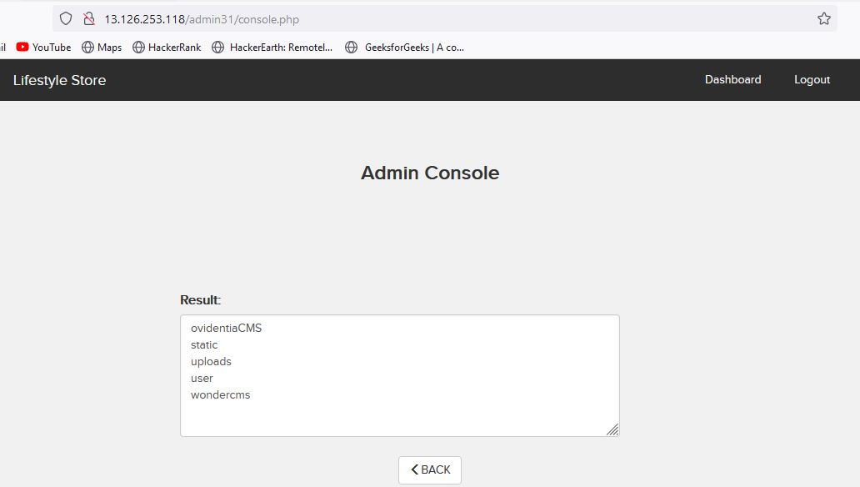

Slide 44
Business Impact – High
If the attacker enters into the admin account and finally to the console url ,the he can put in any malicious code to extract or even edit data ,as he the has the admin privileges.
Other than entering malicious code , the attacker can even get the details of the websites and its components like i version and hence find vulnerabilities to exploit them.
If successfully exploited, impact could cover loss of confidentiality, loss of integrity, loss of availability, and/or loss of accountability.
Recommendation :
There should be filters so that malicious code cannot be injected in .
Input validation can be done.
Output Validation can be done.
Canonicalization can also be done.
References :
https://www.owasp.org/index.php/Command_Injection
https://www.owasp.org/index.php/Code_Injection

Slide 45
7 . Reflected and Stored Cross Site Scripting
This happens when a user controlled input is reflected somewhere else in HTML page and is not encoded / sanitized properly .
This lead to an attacker being able to inject HTML code in the affected pages .
Reflected and Stored Cross Site Scripting | Below mentioned parameters are vulnerable to reflected XSS . Affected URL : http://13.126.253.118/products/details.php?p_id=3 Affected Parameters : POST button under Customer Review (POST parameters) Payload: <script>alert(1)</script> Affected URL : http://13.126.253.118/profile/16/edit/ Affected Parameters : Address (POST parameters) Payload: <script>alert(0)</script>

Slide 46
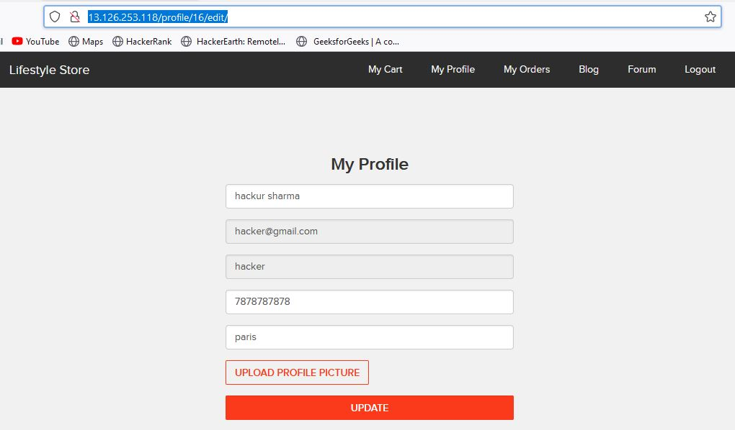
Observation :
Navigate to - http://13.126.253.118/profile/16/edit/ .
You will see user’s details .

Slide 47
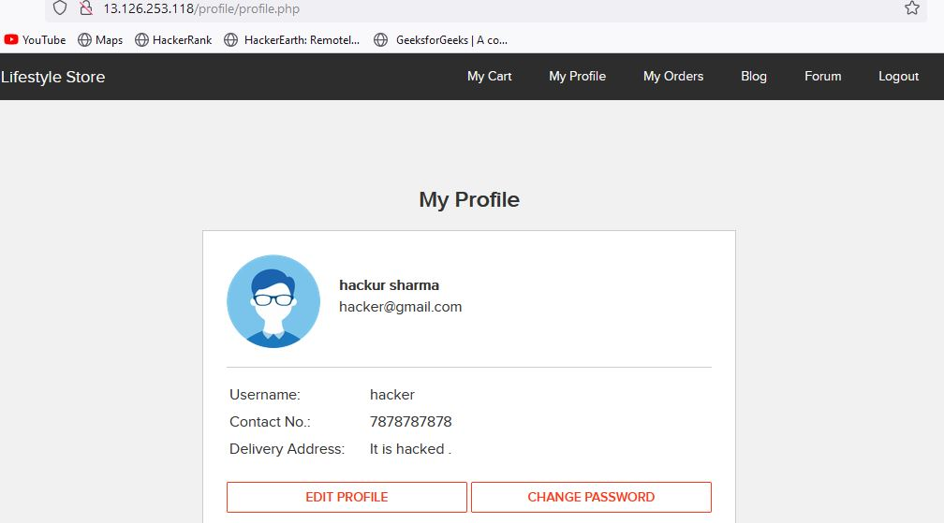
Observation :
Enter any text and click on Update , you will see it reflected in the next page and value will be in POST parameter in Address field.

Slide 48
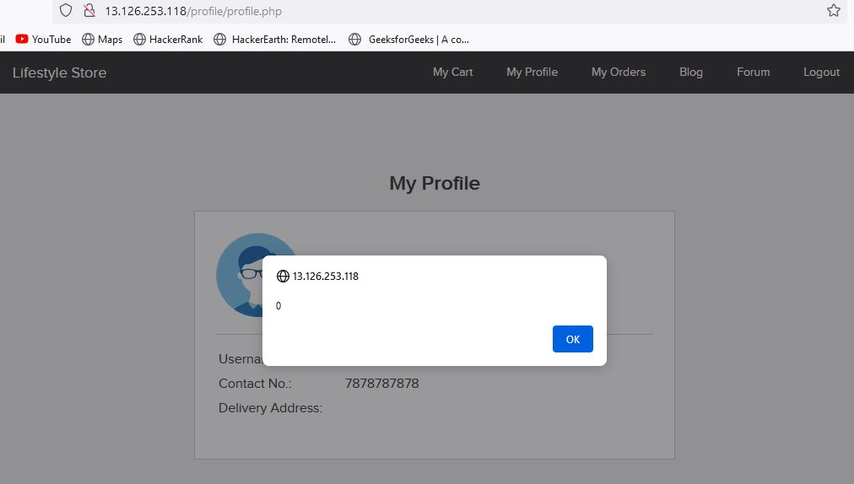
Observation :
Put this payload instead of It is hacked : <script>alert(0)</script>
As you can see we executed custom JS causing popup

Slide 49
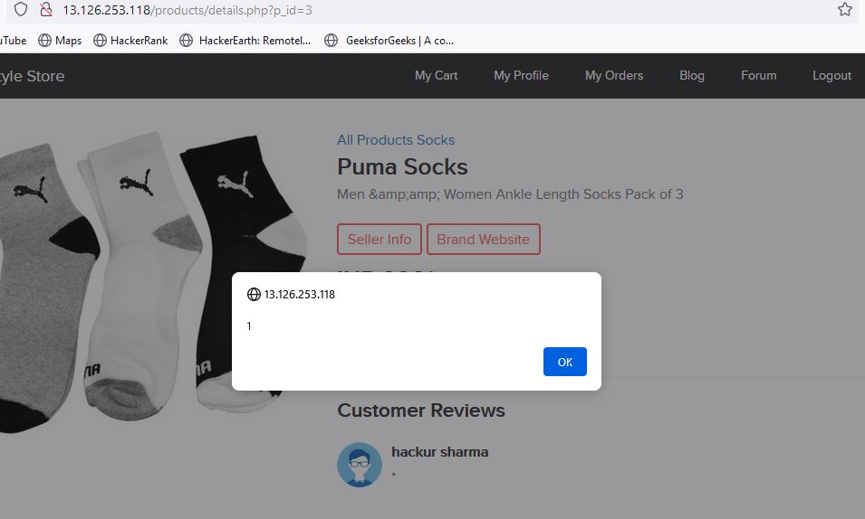
Proof of Concept (PoC) :

Slide 50
Business Impact – High
As attacker can inject arbitrary HTML CSS and JS via the URL, attacker can put any content on the page like phishing pages, install malware on victim’s device and even host explicit content that could compromise the reputation of the organisation .
All attacker needs to do is send the link with the payload to the victim and victim would see hacker controlled content on the website. As the user trusts the website, he/she will trust the content.
Recommendation :
Take the following precautions:
Sanitise all user input and block characters you do not want
Convert special HTML characters like ‘ “ < > into HTML entities &quot; %22 &lt; &gt; before printing them on the website.
Apply Client Side Filters to prevent client side filters bypass.
References :
https://www.owasp.org/index.php/Cross-site_Scripting_(XSS)
https://en.wikipedia.org/wiki/Cross-site_scripting
https://www.w3schools.com/html/html_entities.asp

Slide 51
8 . Crypto Configuration Flaws
Crypto Configuration Flaw (Severe) | Crypto Configuration Flaws are found in the modules below. Affected URL : http://13.126.253.118/ (All the webpages ,blogs ,forum)

Slide 52
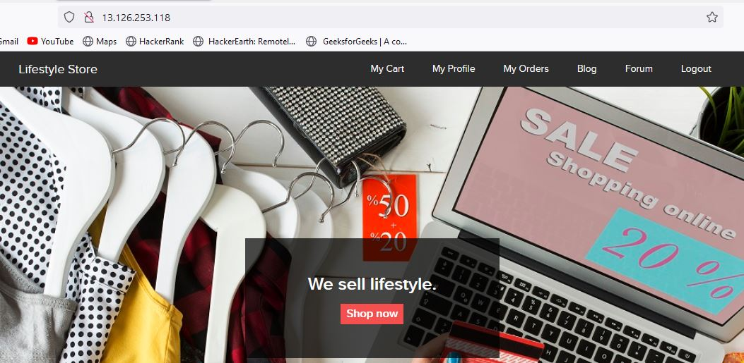
Observation :
Clearly all the webpages use 'http' and not 'https' which is less secure and not encrypted .

Slide 53
Business Impact - High
Security is almost halved in http providing easy man-in-the-middle attack and others which makes it easy for attacker to go through the data transmitted over the internet.
Recommendation :
Use https instead of http as the protocol.
References :
https://www.owasp.org/index.php/Category:Cryptographic_Vulnerability
https://www.w3.org/Protocols/rfc2616/rfc2616-sec15.html

Slide 54
9 . Weak Passwords
Weak Password Flaw (Severe) | Below given URLs have weak passwords. Affected URL : http://13.232.29.146/userlist.txt http://13.232.29.146/wondercms/

Slide 55
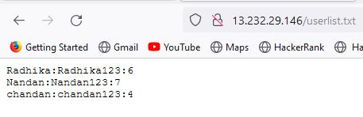
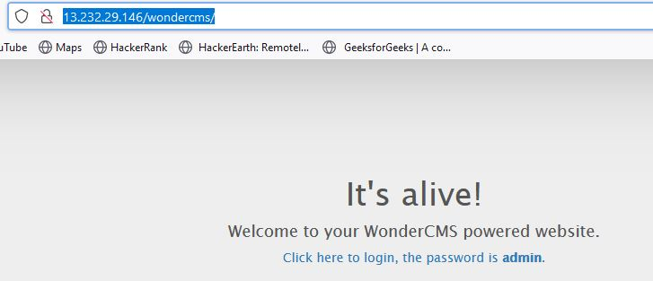
Observation :
The passwords of sellers and admin of blog is very common and easily predictable.

Slide 56
Business Impact - High
Easy, default and common passwords make it easy for attackers to gain access to their accounts illegal use of them and can harm the website to any extent after getting logged into privileged accounts.
Recommendation
There should be password strength check at every creation of an account.
There must be a minimum of 8 characters long password with a mixture of numbers ,alphanumeric ,special characters ,etc.
There should be no repetition of password ,neither on change nor reset.
The password should not be stored on the web, rather should be hashed and stored.
References
https://www.acunetix.com/blog/articles/weak-password-vulnerability-common-think/
https://www.owasp.org/index.php/Testing_for_Weak_password_policy_(OTG-AUTHN-007)

Slide 57
10. Unauthorised availability of Details
Unauthorised availability of Details (Severe) | The Show My Orders module is vulnerable from an Insecure Direct Object Reference (IDOR) that allows attacker see to anyone's user details. Affected URL : http://13.232.29.146/orders/orders.php?customer=16 Affected Parameters : customer (GET parameters) Payload used: http://13.232.29.146/orders/orders.php?customer=3 Similarly other vulnerable URLs are given below http://13.232.29.146/orders/orders.php?customer=2 http://13.232.29.146/orders/orders.php?customer=13 http://13.232.29.146/orders/orders.php?customer=14 http://13.232.29.146/orders/orders.php?customer=5 http://13.232.29.146/orders/orders.php?customer=8

Slide 58
Unauthorised availability of Details (Severe) | The Show My Orders module is vulnerable from an Insecure Direct Object Reference (IDOR) that allows attacker see to anyone's Bill details . Affected URL : http://13.232.29.146/profile/16/edit/ Affected Parameters : User_id (GET parameters) Payload used: http://13.232.29.146/profile/3/edit/

Slide 59
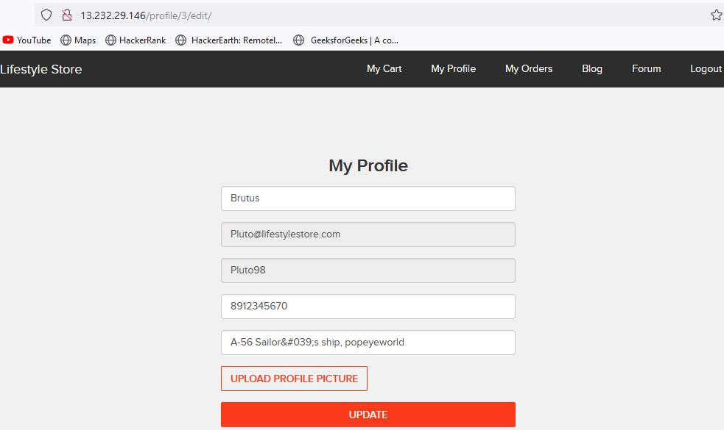
Observation :
Login using any customer of the month’s details. Then navigate to the below link.
http://13.232.29.146/profile/16/edit/
Now remove 16 and insert 3 in the URL like shown in the given screenshot and you will see the details of another user .

Slide 60
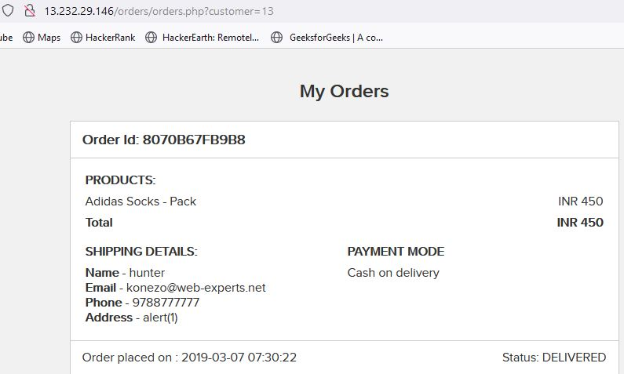
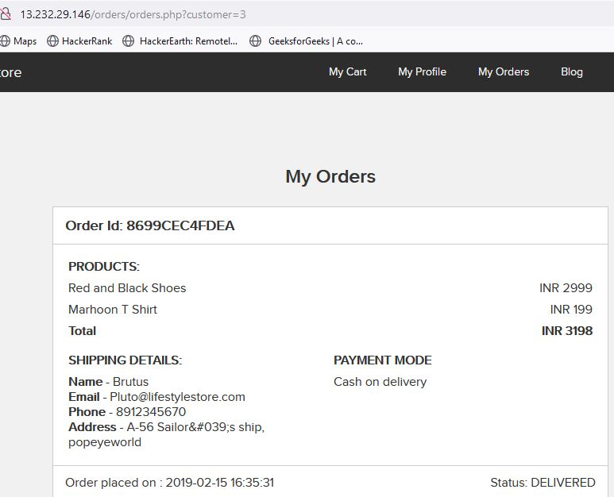
Proof of Concept (PoC) :
Below are the screenshots of the bill detail’s of another user accessed from attacked user’s accounts.
IMG 1 is of customer 13 & IMG 2 is of customer 3
IMG 1
IMG 2

Slide 61
Business Impact – Extremely High
A malicious hacker can read bill information and account details of any user just by knowing the customer id and User ID. This discloses critical billing information of users including:
Mobile Number
Bill Number
Billing Period
Bill Amount and Breakdown
Phone no. and email address
Address
This can be used by malicious hackers to carry out targeted phishing attacks on the users and the information can also be sold to competitors/black-market.
More over, as there is no rate limiting checks, attacker can brute force the user_id for all possible values and get bill information of each and every user of the organization resulting is a massive information leakage.
Recommendation :
Take the following precautions:
Implement proper authentication and authorisation checks to make sure that the user has permission to the data he/she is requesting .
Use proper rate limiting checks on the number of request comes from a single user in a small amount of time
Make sure each user can only see his/her data only.
References :
https://www.owasp.org/index.php/Insecure_Configuration_Management
https://www.owasp.org/index.php/Top_10_2013-A4-Insecure_Direct_Object_References

Slide 62
11 . Open Redirection
Open Redirection (Severe) | The Language module is vulnerable to open redirection. Affected URL : http://13.232.29.146/?includelang=lang/fr.php http://13.232.29.146/?includelang=lang/en.php Affected Parameter : Lang (GET parameters) Payload used: http://13.232.29.146/?includelang=https://google.com/?lang/fr.php Other Affected URL : http://13.232.29.146/products/details.php?p_id=5

Slide 63
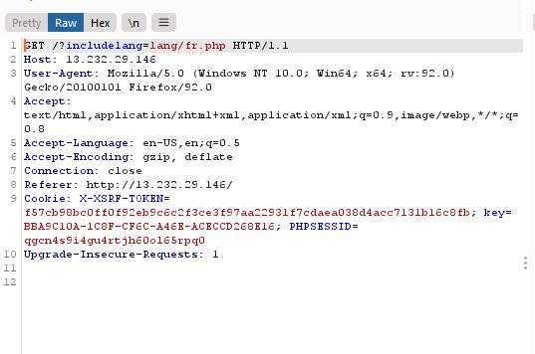
Observation
Navigate to http://13.232.29.146/ and under the Lang tab click on French.
Capture this request in local proxy

Slide 64
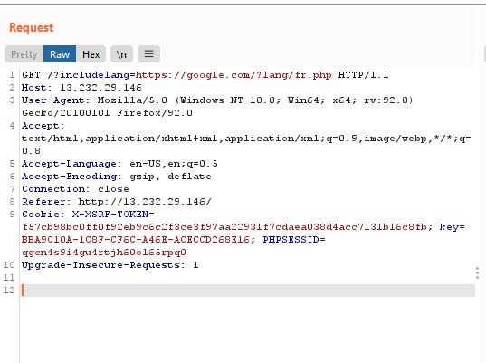
Observation :
Now edit the request like this : GET /?includelang=https://google.com/?lang/en.php HTTP/1.1
Then pass this request in the browser. You will see the google.com .

Slide 65
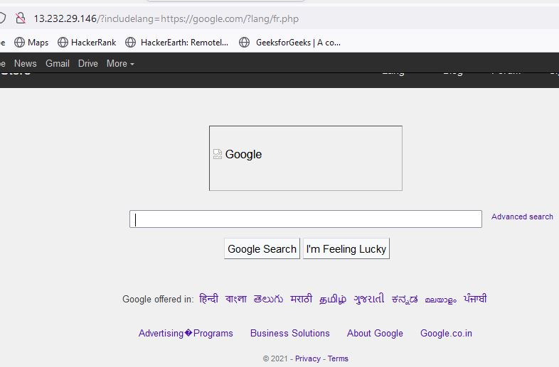
Proof of Concept (PoC) :

Slide 66
Business Impact – Extremely High
An http parameter may contain a URL value and could cause the web application to redirect the request to the specified URL. By modifying the URL value to a malicious site, an attacker may successfully launch a phishing scam and steal user credentials. Because the server name in the modified link is identical to the original site, phishing attempts have a more trustworthy appearance.
Recommendation :
Disallow Offsite Redirects.
If you have to redirect the user based on URLs, instead of using untrusted input you should always use an ID which is internally resolved to the respective URL.
If you want the user to be able to issue redirects you should use a redirection page that requires the user to click on the link instead of just redirecting them.
You should also check that the URL begins with http:// or https:// and also invalidate all other URLs to prevent the use of malicious URIs such as JavaScript .
References :
https://cwe.mitre.org/data/definitions/601.html
https://www.hacksplaining.com/prevention/open-redirects

Slide 67
12 . Information disclosure due to Default Pages
Directory Listing (Moderate) | Below mentioned URLs disclose server information. Affected URL : http://13.232.29.146/phpinfo.php http://13.232.29.146/robots.txt http://13.232.29.146/composer.lock http://13.232.29.146/composer.json http://13.232.29.146/userlist.txt

Slide 68
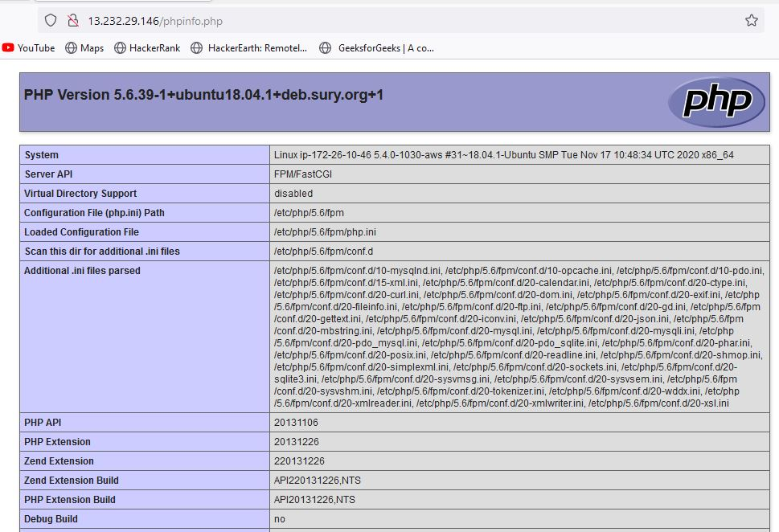
Observation
Navigate to - http://13.232.29.146/phpinfo.php and you will see the below page

Slide 69
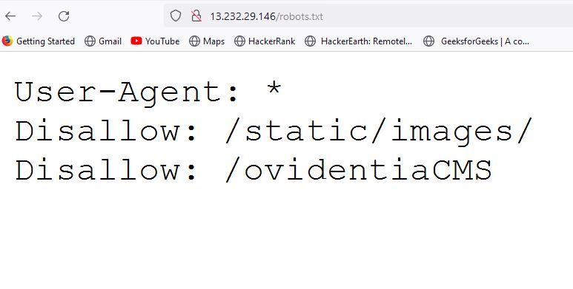
Observation :
Navigate to http://13.232.29.146/robots.txt and you will se the following page.
Next you can navigate to any of the listed files.

Slide 70
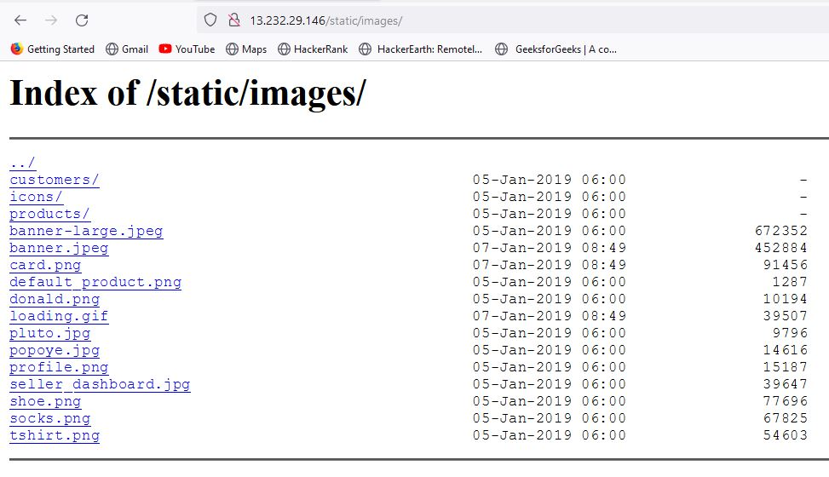
Proof of Concept (PoC) :

Slide 71
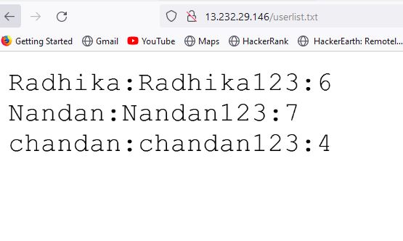
Proof of Concept (PoC) :

Slide 72
Business Impact – Moderate
Although this vulnerability does not have a direct impact to users or the server, though it can aid the attacker with information about the server and the users.
Information Disclosure due to default pages are not exploitable in most cases, but are considered as web application security issues because they allows malicious hackers to gather relevant information which can be used later in the attack lifecycle, in order to achieve more than they could if they didn’t get access to such information.
Recommendation :
Take the following precautions:
Disable all default pages and folders including server-status and server-info.
Multiple security checks enabled on important directories.
References :
https://www.netsparker.com/blog/web-security/information-disclosure-issues-attacks/
https://www.netsparker.com/web-vulnerability-scanner/vulnerabilities/information-disclosure-phpinfo/

Slide 73
13 . Unnecessary Details about Sellers
Unnecessary Details about Sellers (Moderate) | Below mentioned URL gives the unnecessary details about the seller (PII) . Affected URL : http://13.232.29.146/products/details.php?p_id=5

Slide 74
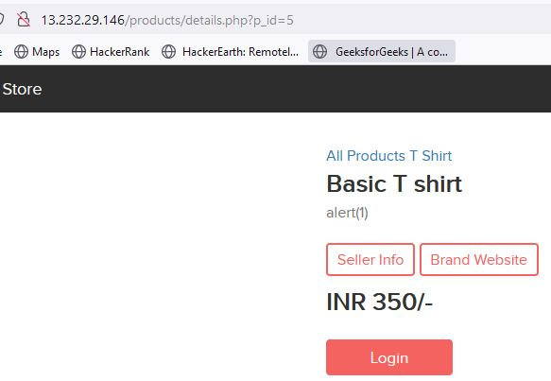
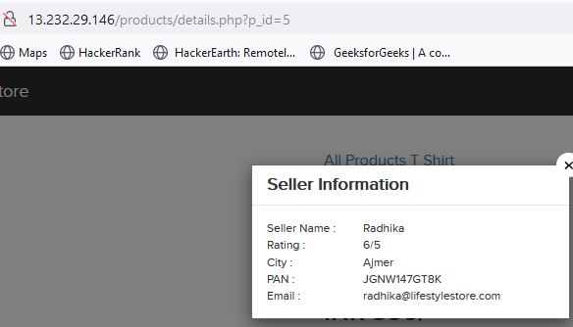
Observation :
When we click on the Seller Info option of any product, we get the details of the seller ,even those which are not required like the pan card number etc.

Slide 75
Business Impact – Moderate
There is no direct business impact in this case ,but this amount of information can definitely lead to social engineering attacks on the seller and can indirectly harm the business.
The information could be sold to rival business companies .
Sellers can be unnecessarily be pranked.
Recommendation :
Only name and email is sufficient as far as the query or help is concerned.
References :
https://digitalguardian.com/blog/how-secure-personally-identifiable-information-against-loss-or-compromise

Slide 76
14 . Components with known vulnerabilities
Components with known Vulnerabilities (Moderate) | Server used is nginx/1.14.0 appears to be outdated (current is at least 1.17.3 ) i.e. it is known to have exploitable vulnerabilities. WonderCMS

Slide 77

Observation :
The PHP version installed is not the latest one and has multiple vulnerabilities that can be exploited . Also wonderCMS is also outdated and highly vulnerable.

Slide 78


Slide 79
Business Impact – High
Exploits of every vulnerability detected is regularly made public and hence outdated software can very easily be taken advantage of . If the attacker comes to know about this vulnerability ,he may directly use the exploit to take down the entire system, which is a big risk.
Recommendation :
Upgrade to the latest version of Affected Software/theme/plugin/OS which means latest version.
If upgrade is not possible for the time being, isolate the server from any other critical data and servers.
References :
https://usn.ubuntu.com/4099-1/
http://securitywarrior9.blogspot.com/2018/01/vulnerability-in-wonder-cms-leading-to.html

Slide 80
15 . Improper Server Side and Client Side Filters
Improper Server Side and Client Side Filters (Low) | Below mentioned URLs have improper server side filter . Affected URL : http://3.108.196.40/profile/16/edit/ Affected parameter : Contact Number (POST Parameter) Payload used : 9000000000 Other Affected URL : http://3.108.196.40/forum/index.php?u=/user/register

Slide 81


Observation :
After logging in as customer, when we try to edit the phone number to some invalid one , the error is as shown.
Also if mobile number with correct length is entered but actually doesn’t exist, it is validated.

Slide 82

Proof of Concept (PoC) :
But when we give a valid phone number on the client side, but intercept it through burpsuite and again give invalid number, it gets accepted.

Slide 83
Business Impact - Low
The data provided by the user ,if incorrect, is not a very big issue but still must be checked for proper validatory information .
Recommendation :
Implement all critical checks on server side code only.
Client-side checks must be treated as decoratives only.
All business logic must be implemented and checked on the server code. This includes user input, the flow of applications and even the URL/Modules a user is supposed to access or not.
References :
http://projects.webappsec.org/w/page/13246933/Improper%20Input%20Handling
https://www.owasp.org/index.php/Unvalidated_Input

Slide 84
16 . Default Error Display
Default Error Display (Low) | Below mentioned URLs have default error displaying on fuzzing : Affected URL : http://3.108.196.40/?includelang=lang/en.php Payload : en’.php (GET Parameter) Affected URL: http://3.108.196.40/search/search.php?q= Parameter: q (GET Parameter) Payload: q='

Slide 85

Observation :
The default error with the path is displayed as:

Slide 86
Proof of Concept (PoC) :
When we give socks' in the search option of the home page , we get the error as:

Slide 87
Business Impact - Moderate
Although this vulnerability does not have a direct impact to users or the server, though it can help the attacker in mapping the server architecture and plan further attacks on the server.
Recommendation :
Do not display the default error messages because it not tells about the server but also sometimes about the location .
So , whenever there is an error ,send it to the same page or throw some manually written error.
References :
https://www.owasp.org/index.php/Improper_Error_Handling

Slide 88
Thank You
For any further clarifications/patch assistance, please
contact: 0000000000

